Slide 1

Predicting Whether a Bank Client Will Subscribe For a Term Deposit
09/23/2022

Slide 2

Objectives and Approach
Problem Description/Objectives : ABC Bank wants to sell its term deposit product to customers and before launching the product they want to develop a model which helps them in understanding whether a particular customer will buy their product or not (based on customer's past interaction with bank or other Financial Institution).
Approach: To predict whether a customer will subscribe for a term deposit, we will use the following techniques:
Exploratory Data Analysis
Logistic Regression
Machine Learning Methods
Ensemble (Random Forest)
Deep Learning (Artificial Neural Network)

Slide 3
Data
Target Variable: The target variable that we are trying to predict is ‘y’, which takes a value of 1 if a customer subscribes for a term deposit and 0 if they do not subscribe.
Features: There are a total of 16 features
7 Numerical features (age, balance, etc.)
9 Categorical features (job, marital status, etc.)

Slide 4
Potential Problems with the Data
Missing Values: In both of our datasets, we did not find any missing or NA values, so there was no need to deal with missing values.
Outliers: Most numeric variables in the dataset contained many outliers.
Skewness: Many of the numeric variables in the dataset were skewed, including ‘pdays’, ‘duration’, ‘campaign’, ‘previous’, and ‘balance’.

Slide 5
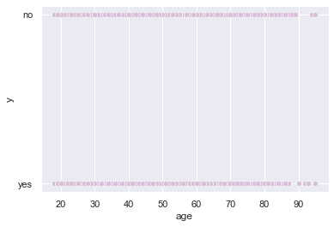
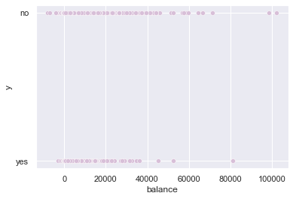
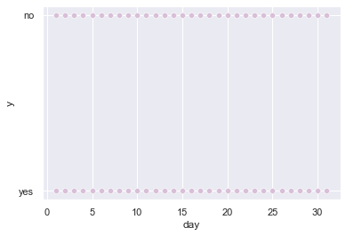
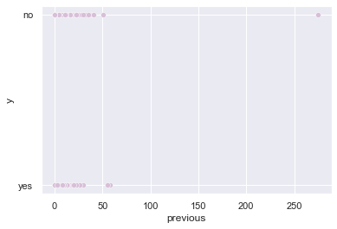
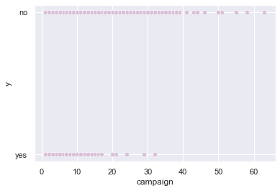
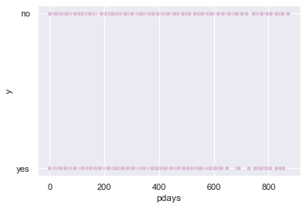
Identifying Outliers and Skewness

Slide 6
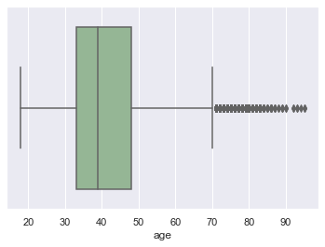
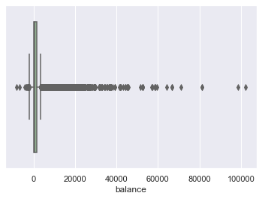
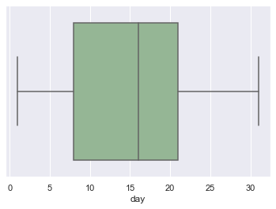
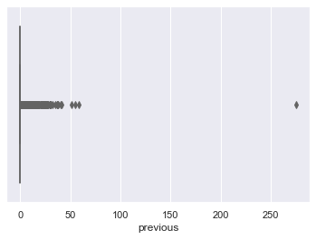
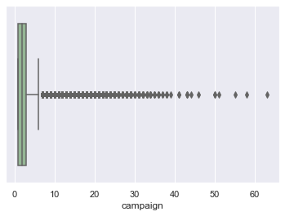
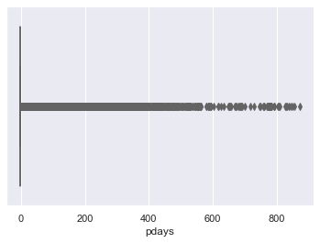
Identifying Outliers and Skewness Cont.

Slide 7
Data Cleaning

Slide 8
Data Cleaning

Slide 9
Exploratory Data Analysis

Slide 10
Exploratory Data Analysis

Slide 11
Exploratory Data Analysis

Slide 12
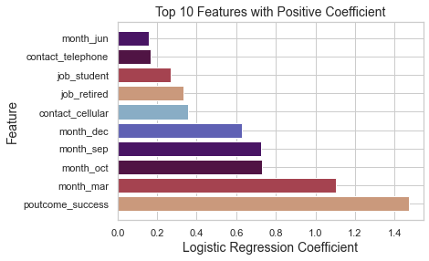
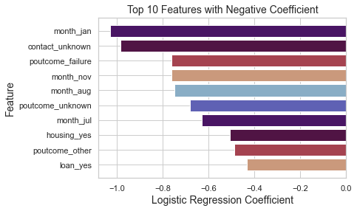
Logistic Regression Model

Slide 13
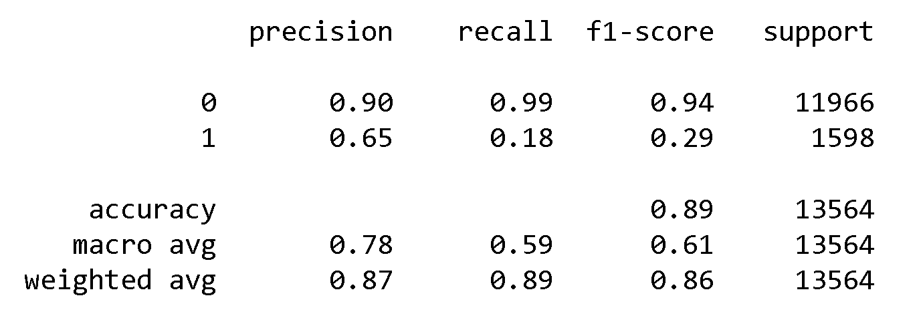
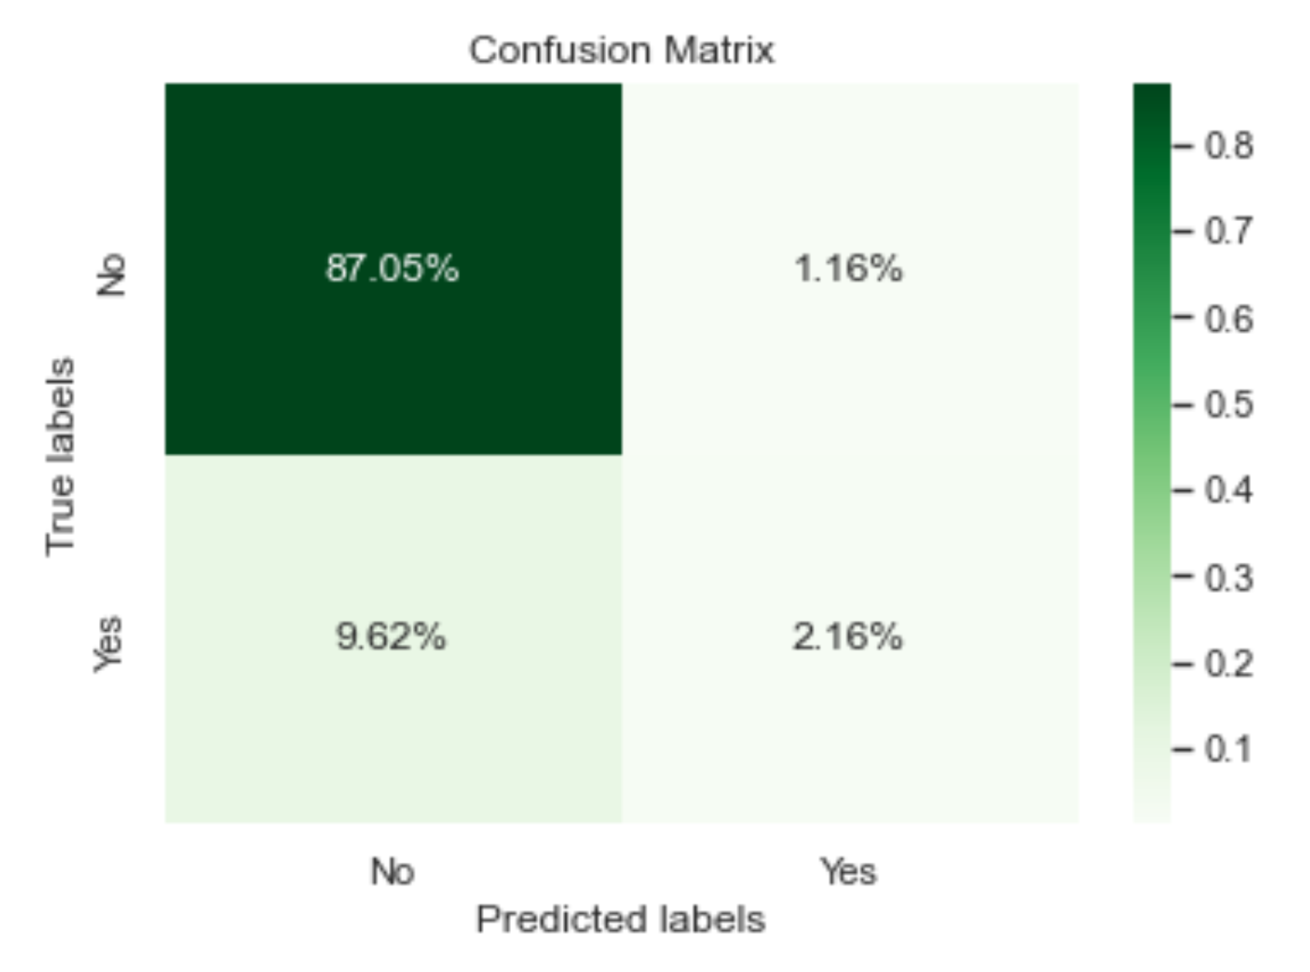
Logistic Regression Model
There are very few false positives (predicted value was ‘Yes’, but actual value was ‘No’), but many false negatives (predicted value was ‘No’, when the actual value was ‘Yes’). The model was very accurate at predicting ‘No’, but performed poorly when it came to predicting ‘Yes’.

Slide 14
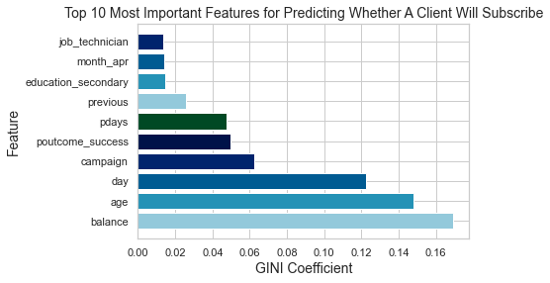
Random Forest

Slide 15
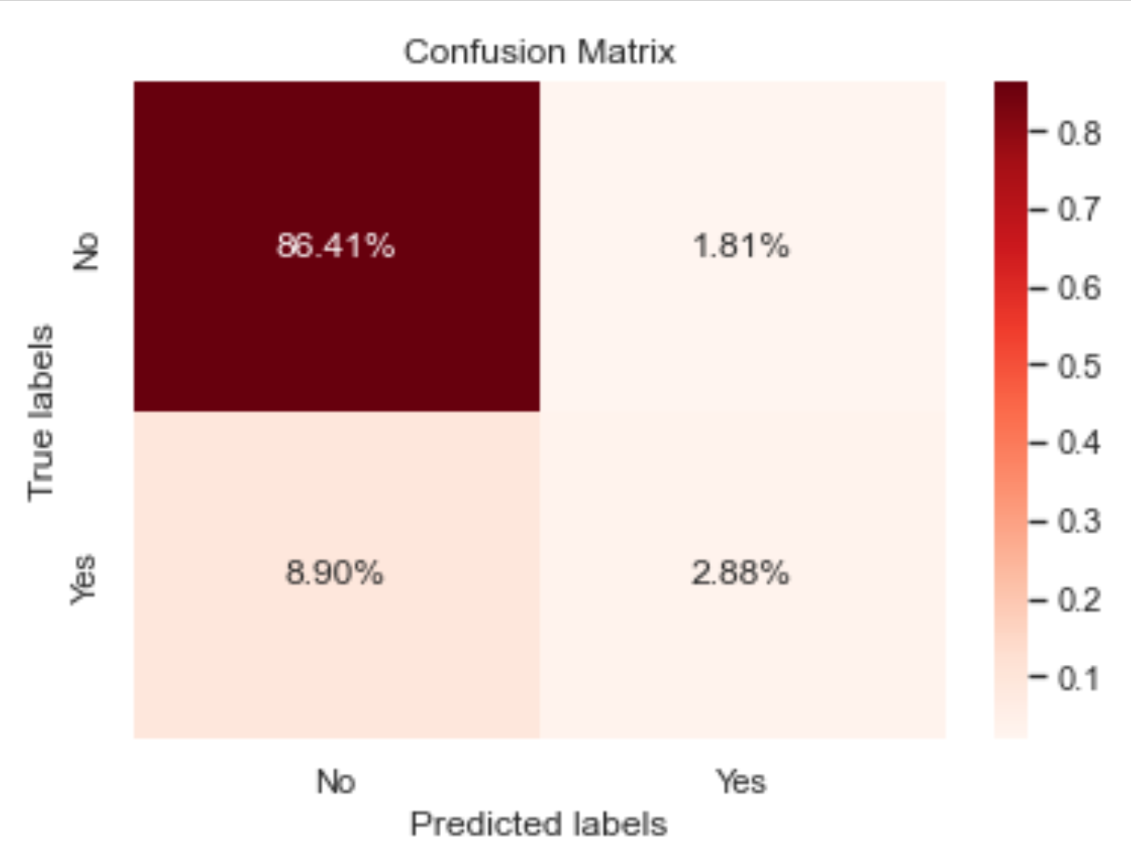
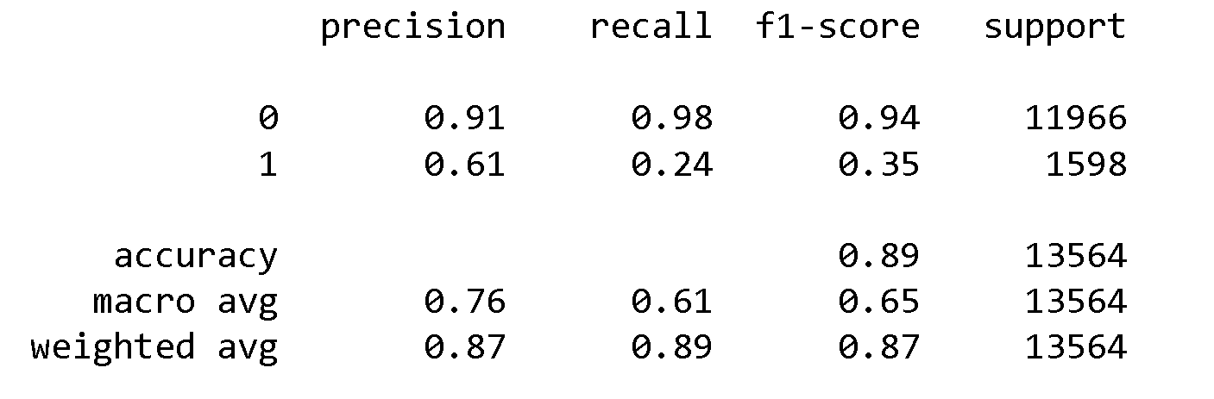
Random Forest
There are very few false positives (predicted value was ‘Yes’, but actual value was ‘No’), but many false negatives (predicted value was ‘No’, when the actual value was ‘Yes’). The model was very accurate at predicting ‘No’, but performed poorly when it came to predicting ‘Yes’.

Slide 16
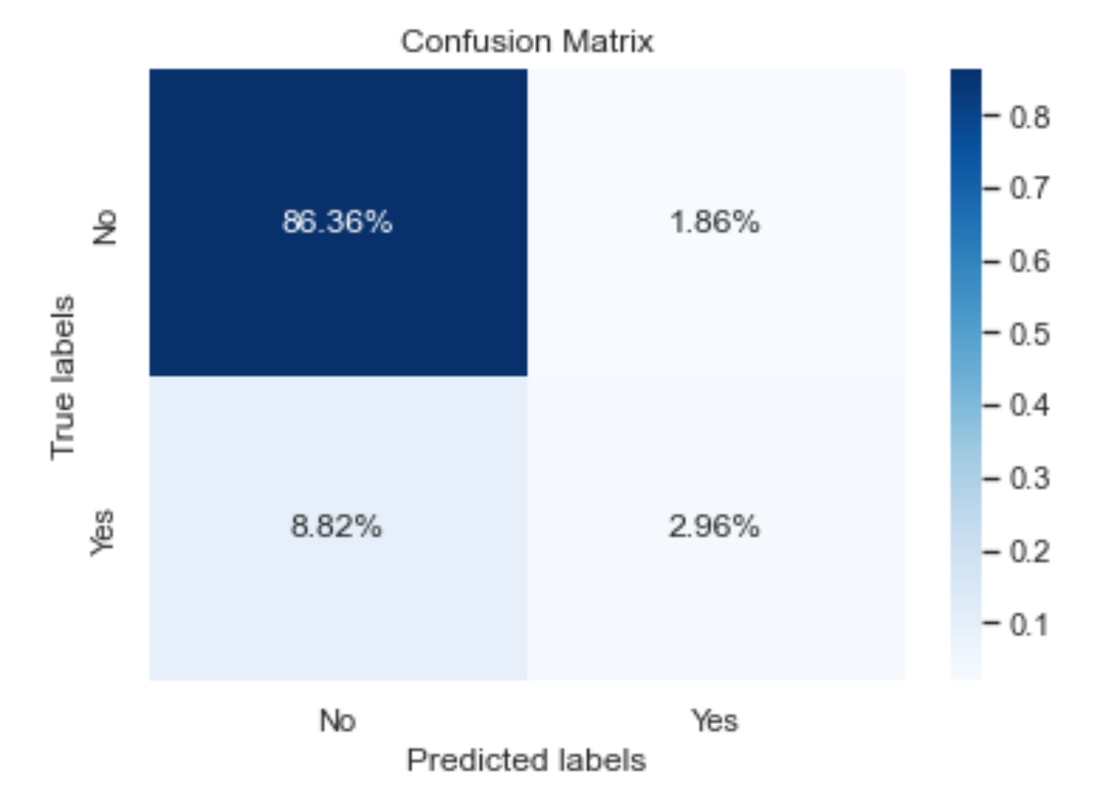
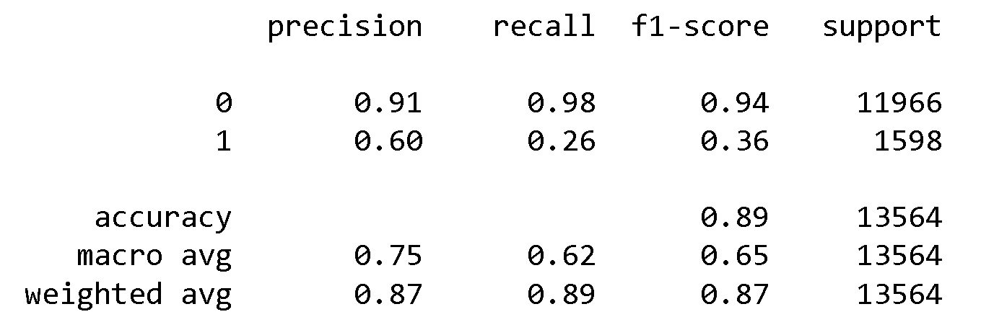
Artificial Neural Network
There are very few false positives (predicted value was ‘Yes’, but actual value was ‘No’), but many false negatives (predicted value was ‘No’, when the actual value was ‘Yes’). The model was very accurate at predicting ‘No’, but performed poorly when it came to predicting ‘Yes’.

Slide 17
Model Evaluation: Selecting the Best Model
All 3 of the models had roughly the same accuracy of 89%. The Artificial Neural Network was slightly better at predicting ‘Yes’ than the other models, but all 3 models had very similar precision, recall, and overall accuracy. We can use any of the 3 models to predict whether a client will subscribe for a term deposit.

Slide 18
Results
According to the results of the Logistic Regression Model, clients are more likely to subscribe for a term deposit if:
The outcome of the previous campaign was successful
It is the month of March, October, September, or December (from most likely to least likely)
They are contacted by cell phone
They are retired or a student
According to the results of the Logistic Regression Model, clients are less likely to subscribe for a term deposit if:
It is the month of January, November, August, or July (from least likely to most likely)
Method of contact is unknown
The outcome of the previous campaign was a failure or unknown
The client has a housing loan or personal loan

